Slide 1

QMS Awareness
Presented by: PALM [Earlier: Process Team]
Copyright © 2021 Cybage Software Pvt. Ltd. All Rights Reserved. Cybage Confidential.
www.cybage.com

Slide 2

Agenda
§ Introduction to PALM
§ Introduction to Quality Management System
§ Quick Glance at Q@Core
§ Project Lifecycles
§ Overview of ALM-DevOps Practices & Integration
§ Processes for Developers & QA – A Quick Look
§ Q&A!
Copyright © 2021 Cybage Software Pvt. Ltd. All Rights Reserved. Cybage Confidential.
www.cybage.com

Slide 3

Introduction to PALM
§ Productivity Assurance & Lifecycle Management (PALM), formerly known as
Process Team
§ Aims to build the culture of Process Oriented & data driven implementation
§ Defines the right set of practices in the organization, with help of Practitioners
§ Emphasis on Tools driven practices rather than manual or documented way
§ Brings the flexibility required in context of project(s); enables adopting &
integrating Customer specific processes
§ Interaction between PALM & Delivery team starts right at the project start.
Copyright © 2021 Cybage Software Pvt. Ltd. All Rights Reserved. Cybage Confidential.
www.cybage.com

Slide 4
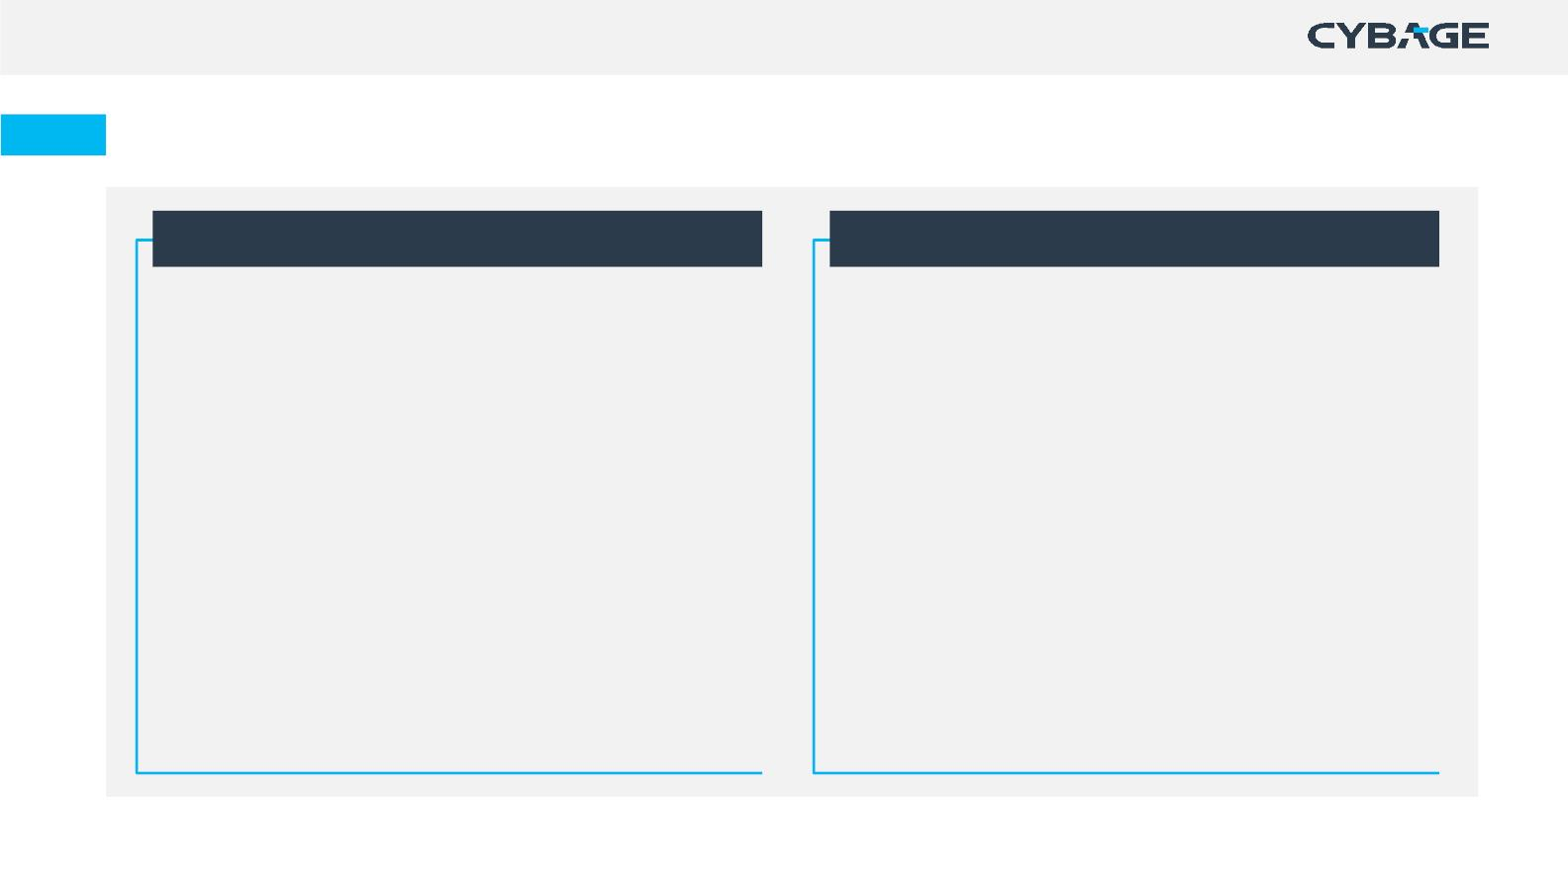
PALM – Functioning
New Customer Care [NCC]
Process Definition & Auditing Team
§ Process setup for New Customer projects
§ Conduct session on Best Practices and required tools
§ ALM tool setup and customization & consulting
§ Facilitates, Reviews and Suggests
§ Process Definition & Maintenance
§ Impart Process & Tool Trainings
§ Provides Process and ALM tool consulting
§ Facilitate Implementation of ALM / Tool driven Practices
§ Conduct Audits on defined periodicity
§ Report Project health to Sr. Management & Executive
Management
§ Report results to Sr. Management
§ Stabilize Process & Tool usage in first 3-4 months
§ Transitions the Project to Auditing Team.
§ Involved in Process automation
§ Facilitate other Continuous Improvement Initiatives.
Copyright © 2021 Cybage Software Pvt. Ltd. All Rights Reserved. Cybage Confidential.
www.cybage.com

Slide 5
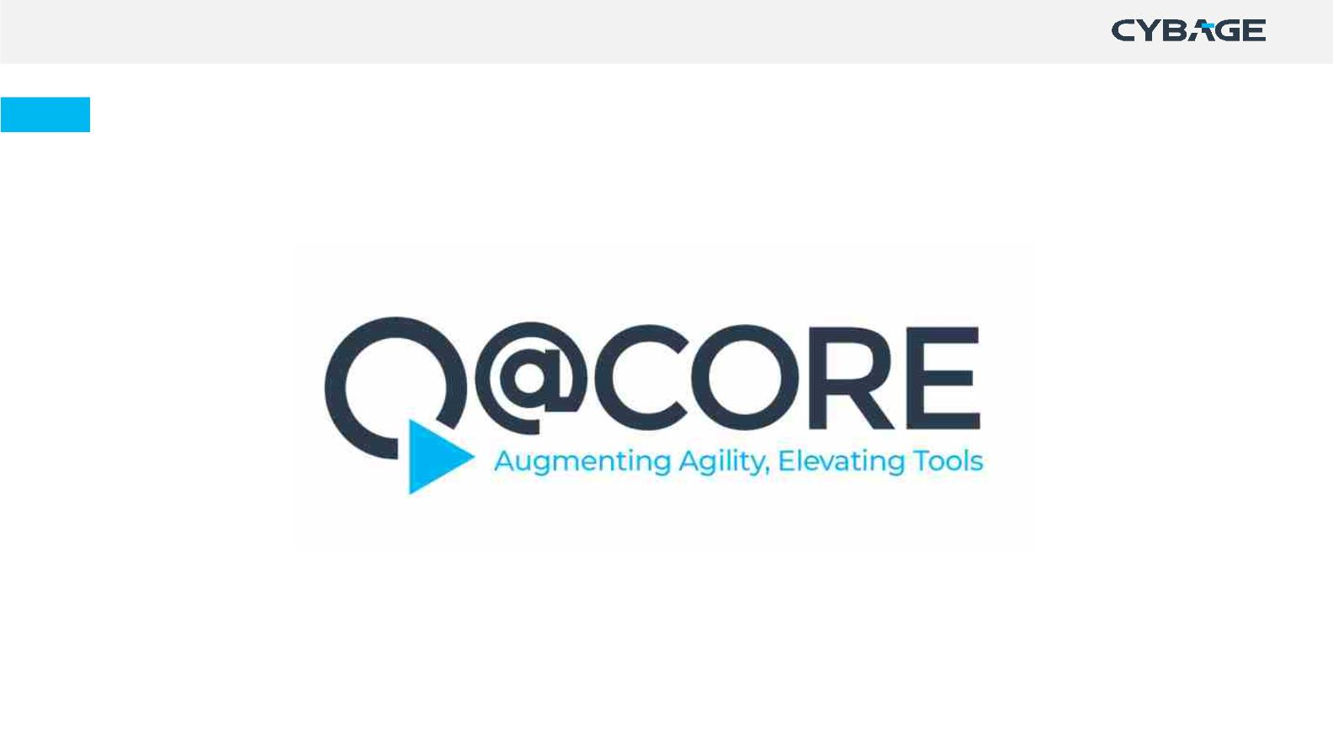
Quality Management System at Cybage
Copyright © 2021 Cybage Software Pvt. Ltd. All Rights Reserved. Cybage Confidential.
www.cybage.com

Slide 6
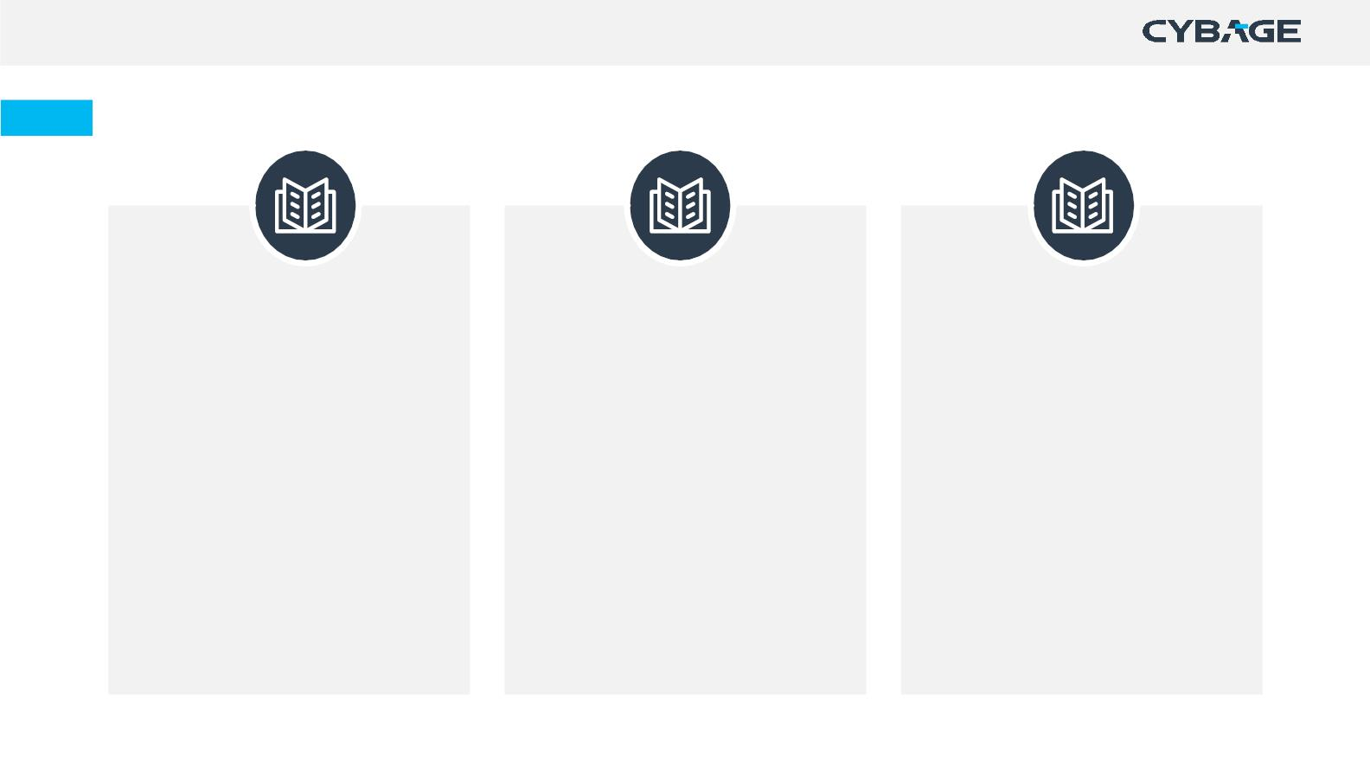
Quick Glance at Q@Core
Apex Manual
Process Manual
Departmental Manual
• Organization information
• Traditional Development
• Engineering
• Human Resource
• Administration
• Organization & Project Structure
• Lifecycles and Execution Models
• Overview of Processes
• Project Management
• Agile Development
• Scrum
• Information System
• Roles and responsibilities
• Information of enabling functions
• Kanban
• Horizontal Processes
• Support Services
• Content Services
• Business Processes
Copyright © 2021 Cybage Software Pvt. Ltd. All Rights Reserved. Cybage Confidential.
www.cybage.com

Slide 7
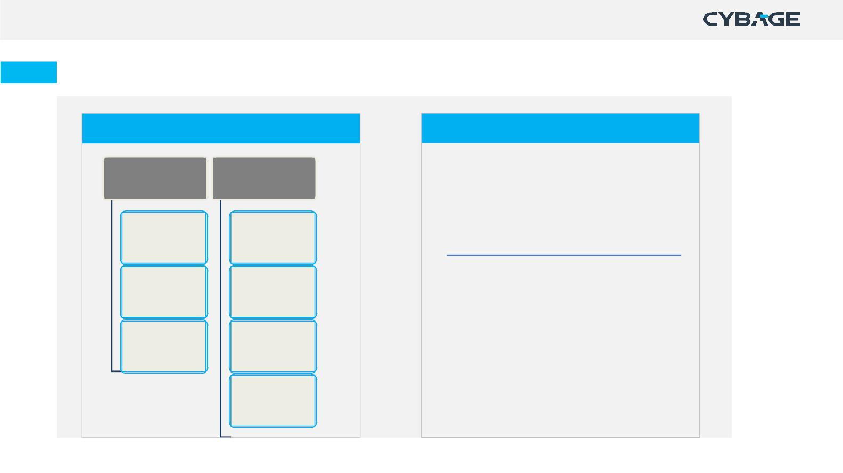
Process Manual
Traditional Development Practices
Agile Development Practices
Engineering
Project
•
Agile Methodology
Management
• Scrum @ Cybage
• Kanban @ Cybage
Development
Lifecycle
Project
Initiation
Testing
Project
•
Project Initiation Process
Lifecycle
Planning &
Monitoring
• Process for Scrum Projects
• Process for Kanban Projects
Maintenance
Lifecycle
Change
Management
Project Closure
Copyright © 2021 Cybage Software Pvt. Ltd. All Rights Reserved. Cybage Confidential.
www.cybage.com

Slide 8
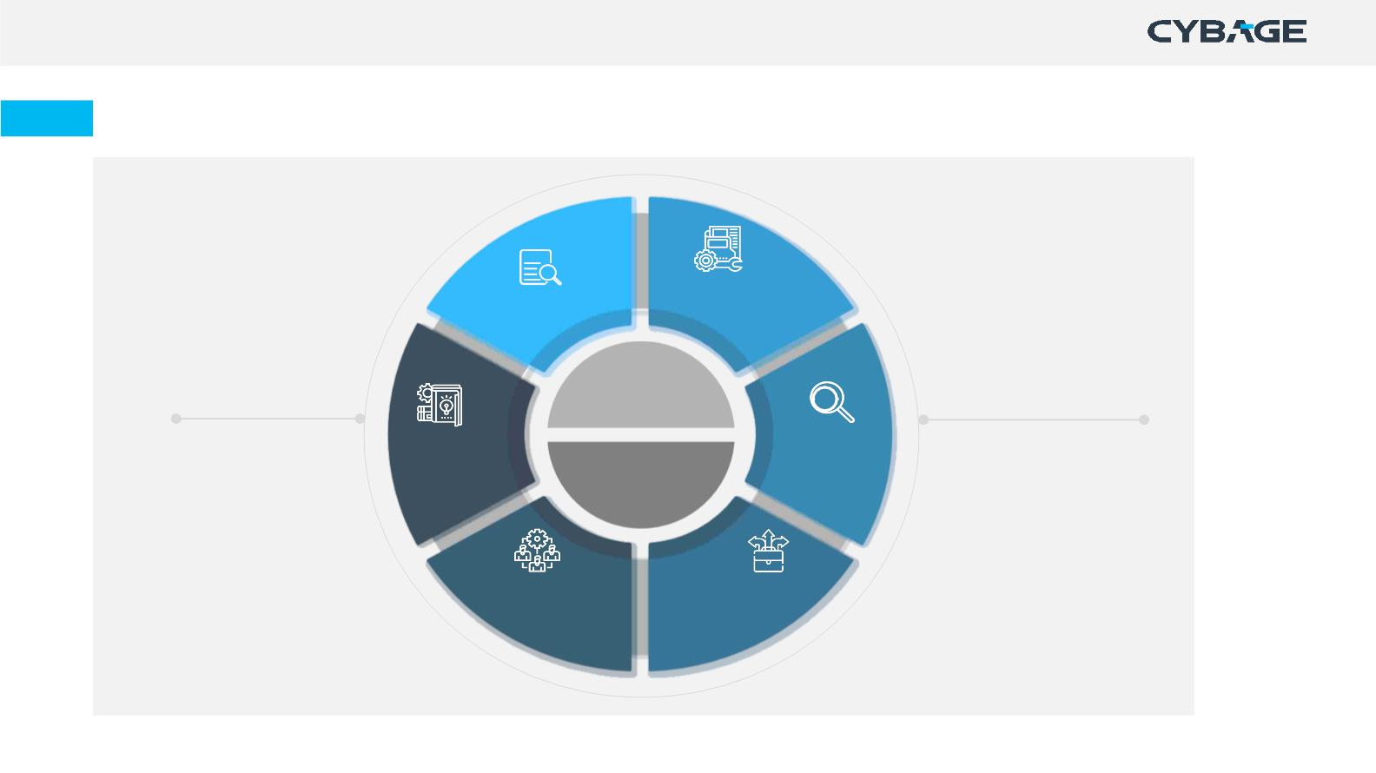
Process Manual
Horizontal Processes
Internal Audits
Configuration
Management
Engineering
QMS
Management
Knowledge
Management
Root Cause
Analysis
Continuous
Improvement
Project
Management
Resource
Management
Decision
Analysis &
Resolution
Copyright © 2021 Cybage Software Pvt. Ltd. All Rights Reserved. Cybage Confidential.
www.cybage.com

Slide 9

Lifecycle & Execution Methodologies
Copyright © 2021 Cybage Software Pvt. Ltd. All Rights Reserved. Cybage Confidential.
www.cybage.com

Slide 10
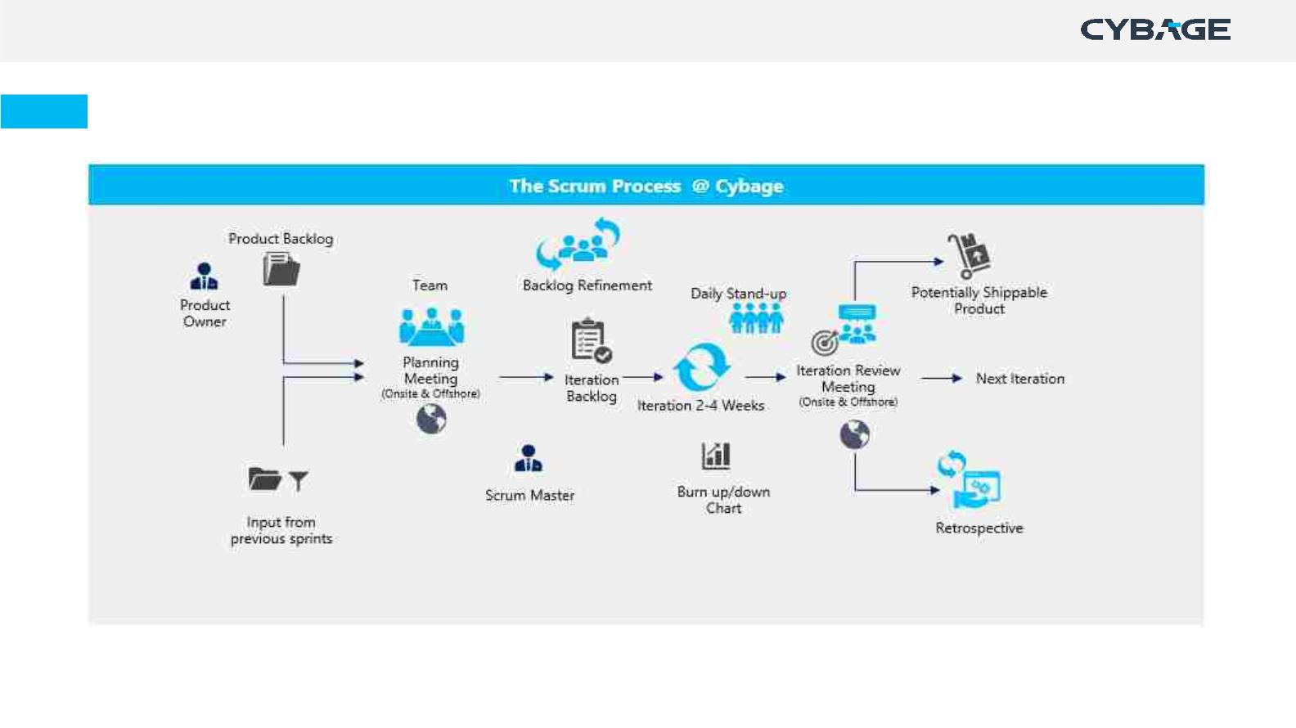
Scrum
Copyright © 2021 Cybage Software Pvt. Ltd. All Rights Reserved. Cybage Confidential.
www.cybage.com

Slide 11
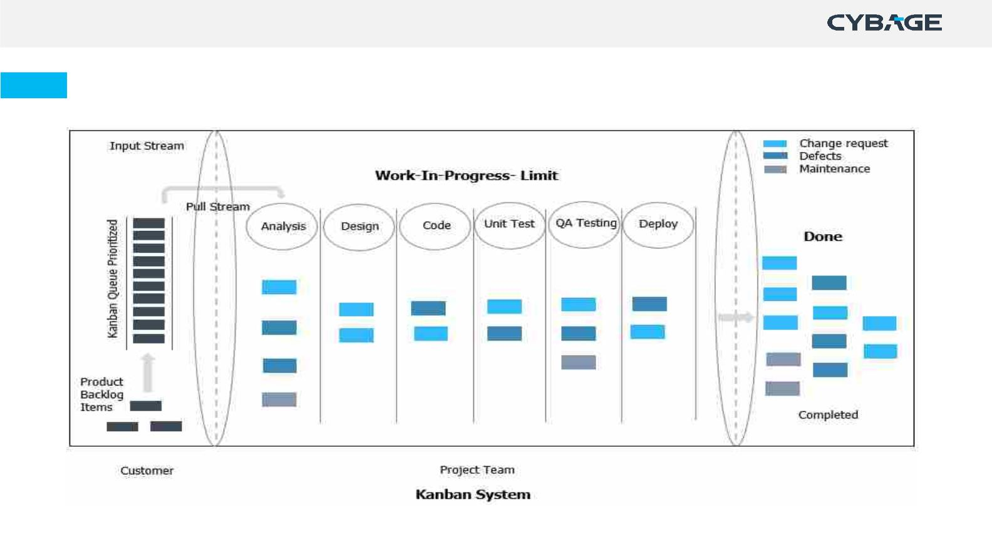
Kanban
Copyright © 2021 Cybage Software Pvt. Ltd. All Rights Reserved. Cybage Confidential.
www.cybage.com

Slide 12
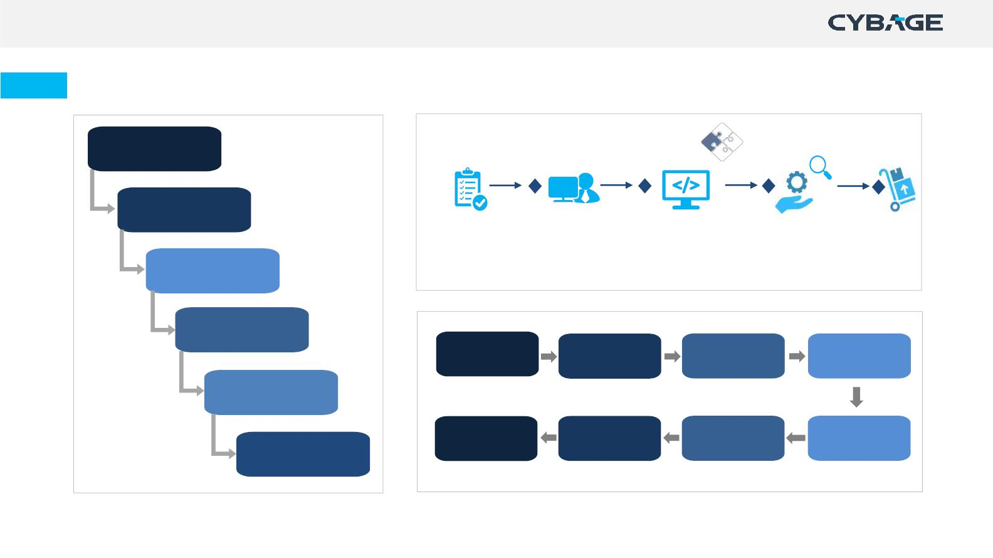
Waterfall, Maintenance & Testing Lifecycle
Requirements
Design
Build & Test
Unit Tests
Maintenance
Request
Impact
Analysis
Implementation
Deploy
Development
Testing
Requirement
Analysis
Test Planning
Test Case
Design
Testing
Deployment
Test Closure
Regression
Testing
Defect
Retesting
Test Result
Reporting
Maintenance
Copyright © 2021 Cybage Software Pvt. Ltd. All Rights Reserved. Cybage Confidential.
www.cybage.com

Slide 13
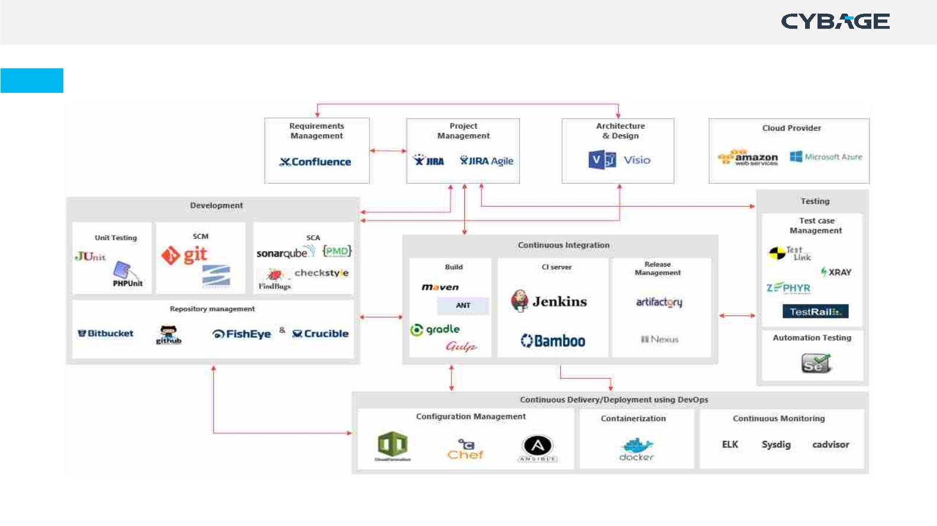
ALM-DevOps Practices & Tool Integration – Opensource & Licensed Tools
Copyright © 2021 Cybage Software Pvt. Ltd. All Rights Reserved. Cybage Confidential.
www.cybage.com

Slide 14
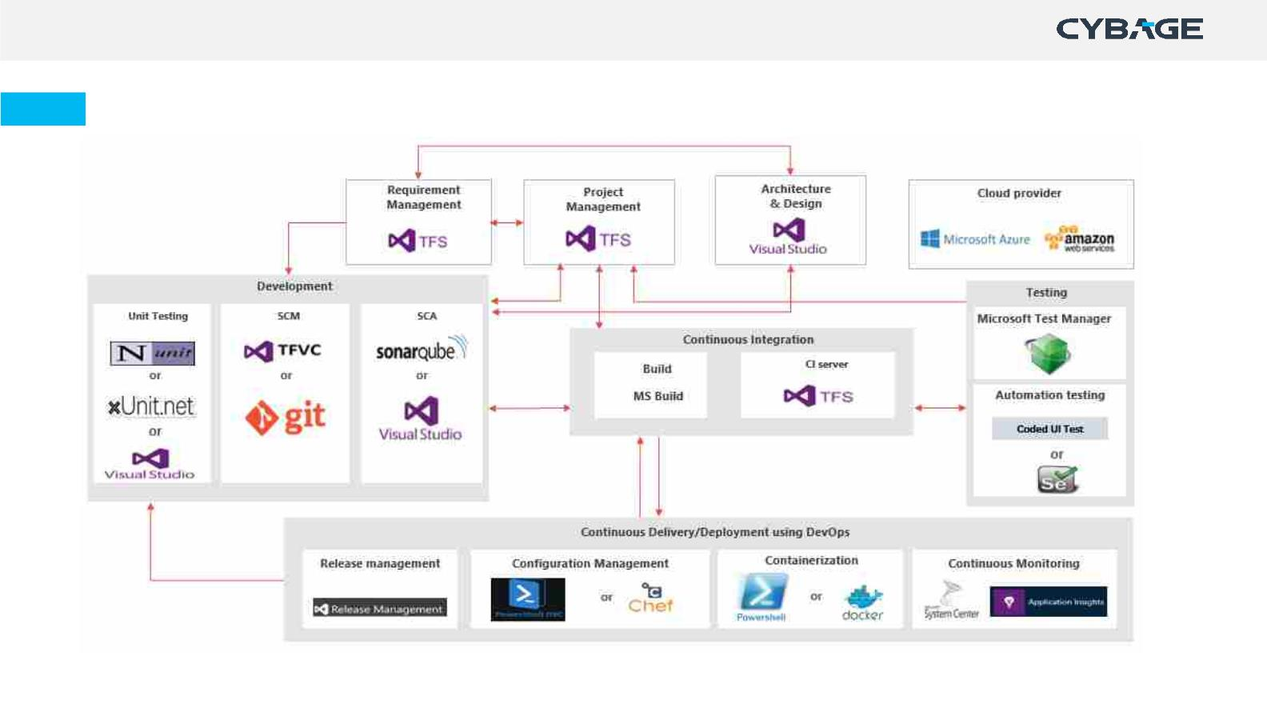
ALM-DevOps Practices & Tool Integration – Microsoft Tools
Copyright © 2021 Cybage Software Pvt. Ltd. All Rights Reserved. Cybage Confidential.
www.cybage.com

Slide 15
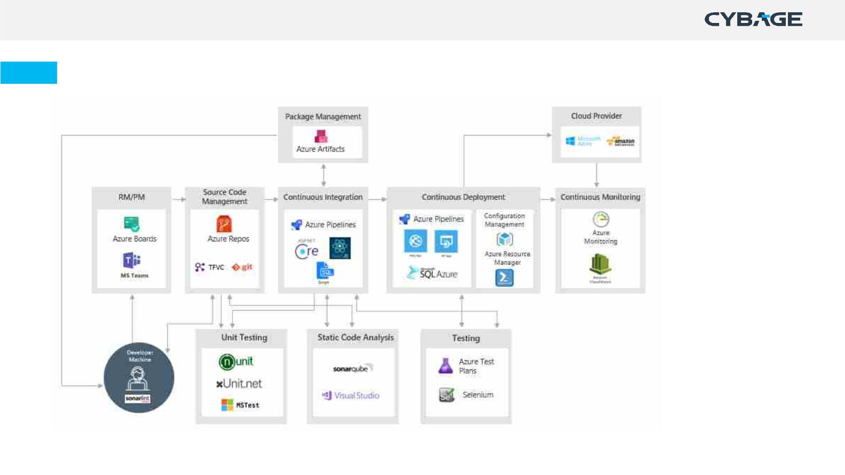
ALM-DevOps Practices & Tool Integration – Microsoft Azure
Copyright © 2021 Cybage Software Pvt. Ltd. All Rights Reserved. Cybage Confidential.
www.cybage.com

Slide 16

Set of Processes – QA’s Involvement
Traditional
Development
Agile
Development
Horizontal
• Development Lifecycle
• Process for Scrum Projects
• Process for Kanban Projects
• Configuration Management
• Root Cause Analysis
• Testing Lifecycle Process
• Performance Testing Process
• Web Accessibility Test Process
• Project Planning & Monitoring
• Resource Management
• Knowledge Management
• Continuous Improvement
Look forward for a detailed session to understand Role & Involvement…
Copyright © 2021 Cybage Software Pvt. Ltd. All Rights Reserved. Cybage Confidential.
www.cybage.com

Slide 17

Set of Processes – Developer’s Involvement
Traditional
Development
Agile
Development
Horizontal
• Development Lifecycle
• Maintenance Lifecycle
• Process for Scrum Projects
• Process for Kanban Projects
• Configuration Management
• Root Cause Analysis
• Project Planning & Monitoring
• Resource Management
• Knowledge Management
• Continuous Improvement
Look forward for a detailed session to understand Role & Involvement…
Copyright © 2021 Cybage Software Pvt. Ltd. All Rights Reserved. Cybage Confidential.
www.cybage.com

Slide 18

Thank You!
Copyright © 2021 Cybage Software Pvt. Ltd. All Rights Reserved. Cybage Confidential.
www.cybage.com

